Slide 1
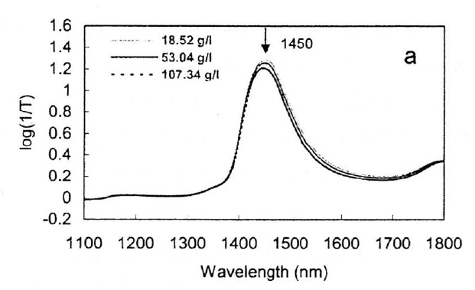
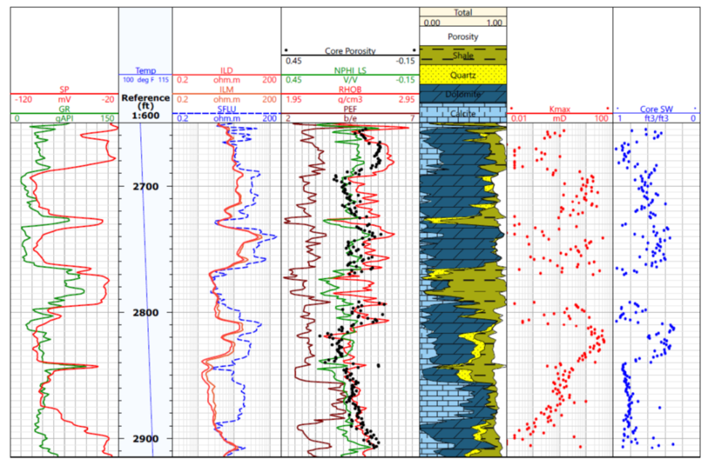
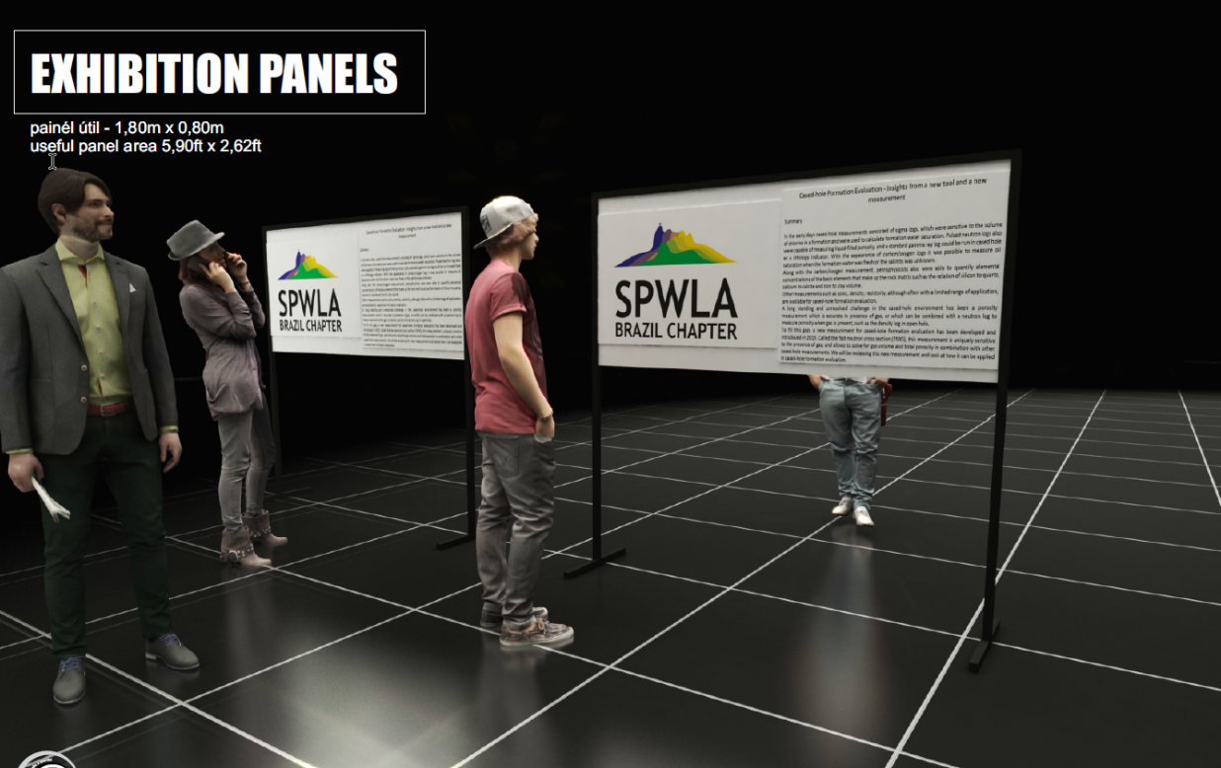

Instructions for Poster Preparation of 2024 65th SPWLA Symposium in Rio de Janeiro, Brazil
MUST INCLUDE NUMBER
Paper SPWLA-2024-xxxx
Author 1, Author 2, Author 3, Author 4, Company Name (should be min ¾ inch)
ALL POSTERS SHOULD BE PREPARED IN PRINTED FORMAT: All posters need to be printed on large paper format (see below for specific dimensions) and will be affixed to stands.
GENERAL: Many of those viewing your poster will do so from about a distance of 1-2 meters / 4 to 6 feet. Most material prepared for a printed page (magazine, journal, book, etc.) is NOT suitable for posters. Grid lines, log traces, small letters, and numbers that are perfectly readable on a printed page may be impossible to read at a normal poster viewing distance. If your graphic material is not legible at normal poster viewing distance it should be redesigned and/or redrafted for your poster presentation. A good practice is to print the components and view them from 2 m / 6 feet to ensure viewers can read all information. A Best Poster Presentation Award will be given by the Technology Committee to encourage the highest quality in poster presentations.
EQUIPMENT: Poster sheet sizes are recommended as 915 cm (36 inch) height x 1525 cm (60 inch) width but should not be larger than 100 cm height x 180 cm width. The poster board itself is 80 cm height x 180 cm width. Posters will be mounted with two-sided tape provided by the poster board providers. (Having a role of regular tape for tears and two-sided tape is worthwhile.)
POSTER TITLE: The poster title and authors should be identified in large letters at the top, the title should be at least 1 inches and authors at least ¾ inch in height.
DISPLAY TIME: Posters must be on display by 8:00 AM, Monday, May 20. All authors are required to be at their poster during their assigned session on Monday, Tuesday or Wednesday afternoon (see the final technical program), which are dedicated sessions for poster viewing. It is recommended to have the 5-7 minute “elevator” speech to cover your poster and answer questions. This may be repeated several times during the specified time. Judges will be circulating during the specified time to rate posters.
Posters are to remain up for the duration of the Symposium. Please remove your poster after 5:00 PM Wednesday. Any poster left there after 5:00 PM on Wednesday will be discarded.
POSTER LOCATION: Posters will be located in a prominent designated area near the session rooms. You will be told where to place your poster when you register at the Symposium. Poster boards will be marked with your Paper number, ie. SPWLA-2024-XXXX.
Notes:
This template is 18 inches height x 30 inches width, a half of the actual poster size
When printing, the paper size should be 36 x 60 inches
Font size of the text should be minimum 18 point
All graphs or plots should have sufficient resolution, texts should be readable
Number sections or number panel so path is clear to follow.
Remove all the red parts in this PPT.
Poster is portrait and posters will be mounted on both sides with two-sided tape provided by Panel provider.
Board size is 80 cm height x 180 cm width (70.9 in x 31.5 in), i.e. landscape orientation.
MAIN SECTIONS ON EACH POSTER:
Introduction (Statement of Problem)
Process/Procedures/Methodology
Observations/Results
Conclusion
Acknowledgements
Supporting workflows, figures, tables with clear scales, grids and legends
Assigned Paper number will be in upper right corner – this should be min 1/2 inch
Top white border min ¾ inch
Title should be min of 1 in with green border be expanded if need larger due to title length
(Upper logo can be dropped IF extra space needed)
The lower green bar should be ~ 1 inch
Color: Dark Blue | Font: Calibri | Font Size: 24 points
Font Style: Calibri | x.xx | 0.21
Font Size: 20 points, Bold | x.xx | 0.32
TEXT-to-Text | x.xx | 0.42
Use Contrasting Colors | 2.3 | 1.7
Your logo

